Slide 1
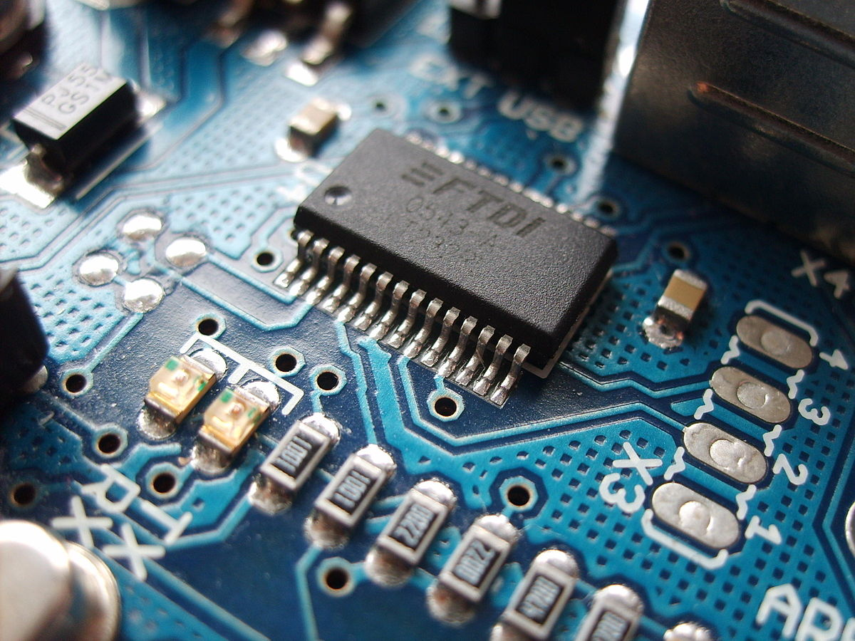
Lab Notebook for EECT 112
By: Jarred Clark
My Lab Partner was Seth Wills
For Lab 4: Lab Partners Seth Wills and Nathaniel Paulus
For Lab 6 and 9: Lab Partners were Seth Wills and Alex Drummond
For Lab 6 My :Lab Partners for the Simulations and results were Steve Kepler and Judo Abaker
Lab Partners for the Builds and Test data for the Circuits were Seth Wills, Alex Drummond and Emmanuel
Labs 1-9

Slide 2
Lab 1-Logic Levels Date: 09-08-2017
My Lab Partner was Seth Wills
The purpose of this lab was to learn how
to create logic levels for digital circuits using switches and resistors.
Equipment Needed:
1- Digital Multimeter
4- 10kohm
1- 4 position dip switch

Slide 3
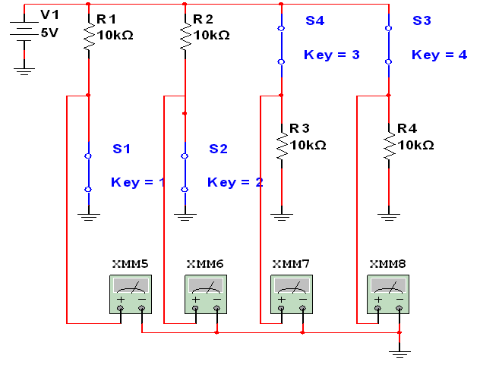
Lab 1 Page 2

Slide 4
Lab 1 Page 3

Slide 5
Lab 1 Page 4
This is the original word document for Lab 1
Lab 1

Slide 6
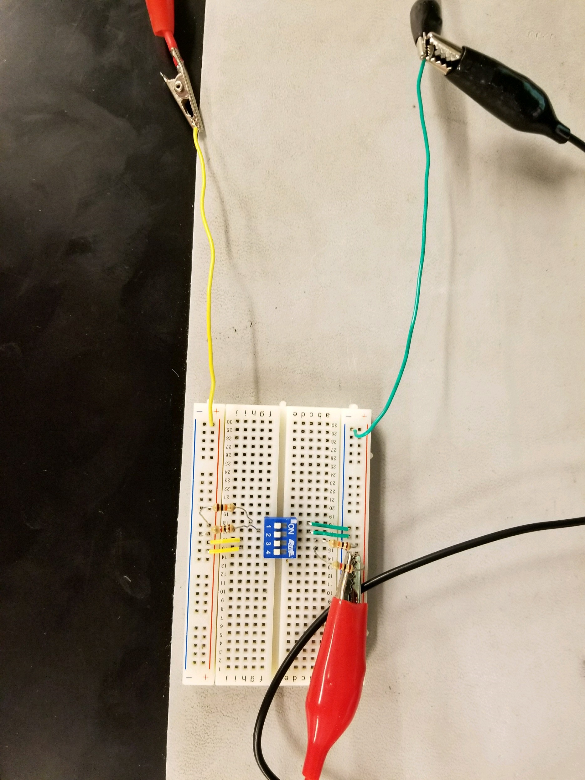
Lab 1: Picture
Simulated a logic circuit using 10k nominal resistor’s
Actual recorded values
R1= 9.802
R2= 9.665
R3= 9.743
R4= 9.725

Slide 7
Lab 2- Number Conversions Date: 09-15-2017
My Lab Partner was Seth Wills
The purpose of this lab is to:
Learn how to convert numbers from one base to another base.

Slide 8
Lab 2: Page Two
Using the Lecture 2a Slide 3.xlxs spreadsheet determine the decimal values for the min and max binary numbers.
5 Bit Binary Min 00000 Decimal value = 0
5 Bit Binary Max 11111 Decimal value = 31
8 Bin Binary Max 11111111 Decimal value = 255
8 Bin Binary Min 00000000 Decimal value = 0
Using the Lecture 2a Slide 5.xlxs spreadsheet determine what decimal value is equal to the maximum binary number for 6 and 7 bits.
6 Bit Binary Max 111111 Decimal value = 63
7 Bit Binary Max 1111111 Decimal value = 127

Slide 9
Lab 2: Page 3
Using the Lecture 2a Slide 7.xlxs spreadsheet determine what decimal values are equal to for the minimum and maximum binary numbers.
Min Decimal No 0 Binary value = 00000
Max Decimal No 31 Binary value = 11111
Using the Lecture 2a Slide 9.xlxs spreadsheet determine what decimal values are equal to for the minimum and maximum binary numbers.
Min Decimal No 0 Binary value = 000000
Max Decimal No 63 Binary value = 111111

Slide 10
Lab 2: Page 4
Using the Lecture 2a Slide 12.xlxs spreadsheet determine what hexadecimal value are equal to for the minimum and maximum decimal numbers.
Min Hexadecimal No. 000 Decimal value =0
Max Hexadecimal No. FFF Decimal value =4095
Using the Lecture 2a Slide 14.xlxs spreadsheet determine what decimal value produces a value of the following values.
Hexadecimal Decimal
000 000
03F 63
07F 126
0FF 255
FFF 4095

Slide 11
Lab 2: Page 5
Using the Lecture 2a Slide 18.xlxs spreadsheet determine what decimal value is equal to the maximum hexadecimal number and binary number.
Max Decimal value = 15 15 15
Hexadecimal value = FFF
Binary value = 111111111111

Slide 12

Lab 2: Page 6
Observations/Conclusion: Hexadecimal is comprised of strings of 4 bits for each individual place value.
0in decimal converting BIN to DEC you lose 1 value for the count of the Max value.
The original word document:
Lab 2

Slide 13
Lab 3-Logic Gates 09-29-17
My Lab Partner was Seth Wills
The purpose of this lab is to:
Learn how to test AND and OR logic gates.
Equipment needed:
1 – Digital Multimeter
2 – 10Kohm
1 – 4 position dip switch
1 – 74LS08
1 – 74LS32
Spreadsheet simulations for Lab 3

Slide 14
Lab 3: Page 2
Simulation using the 74ls08
Also known as the AND gate

Slide 15
Lab 3- Page 3
Simulated |  |  | Test
S1 | S2 | Output | S1 | S2 | Output
0 | 0 | 1 | 0 | 0 | 4.287V
1 | 0 | 0 | 1 | 0 | 0.657V
0 | 1 | 0 | 0 | 1 | 0.654V
1 | 1 | 0 | 1 | 1 | 0.652V
This is the simulation and test results for the dual input AND gate circuit. Part 74LS08

Slide 16
Lab 3: Page 4
This simulation uses the 74ls32
Also known as the OR gate

Slide 17
Lab 3- Page 5
Simulated |  |  | Test
S1 | S2 | Output | S1 | S2 | Output
0 | 0 | 0 | 0 | 0 | 4.242V
1 | 0 | 1 | 1 | 1 | 4.243V
0 | 1 | 1 | 0 | 1 | 4.241V
1 | 1 | 1 | 1 | 1 | 0.164V
This is the simulation and test results for the dual input OR gate circuit. Part 74LS32

Slide 18
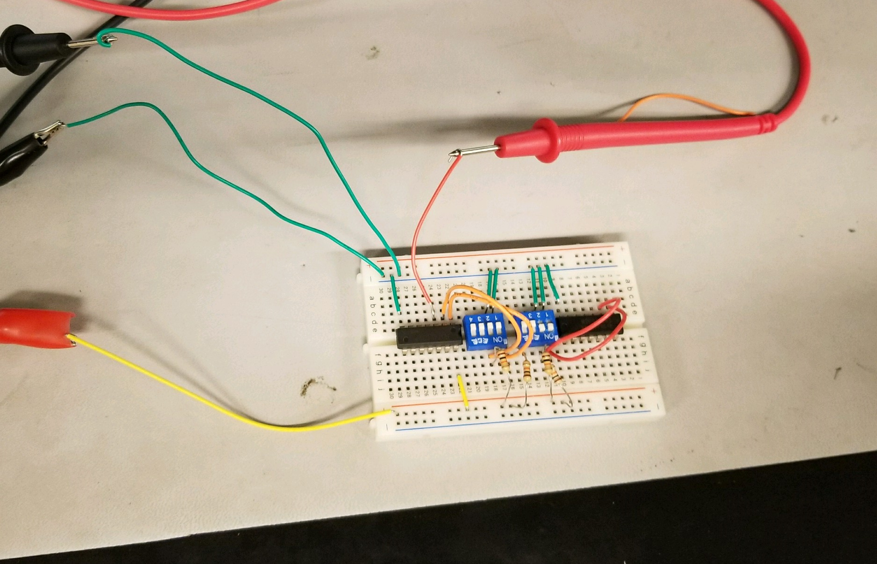
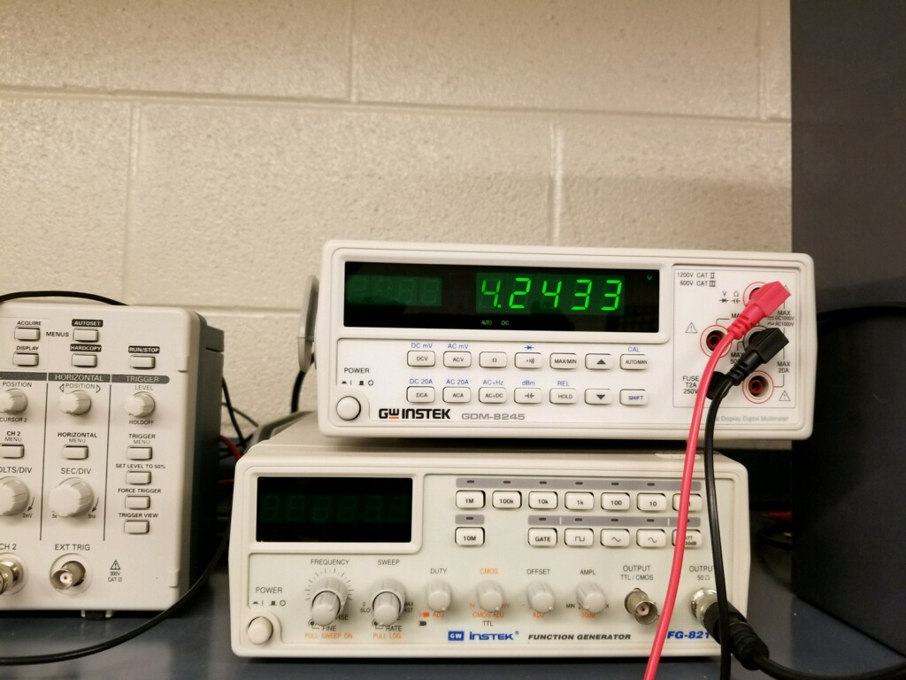
Lab 3-Page 6
Negative
Positive
This is a measurement of the circuit being on a high state reading 4.2433V
This is the circuit that was used for Lab 3 using parts 74ls08, 74ls32 and two 4 position dip switches.

Slide 19
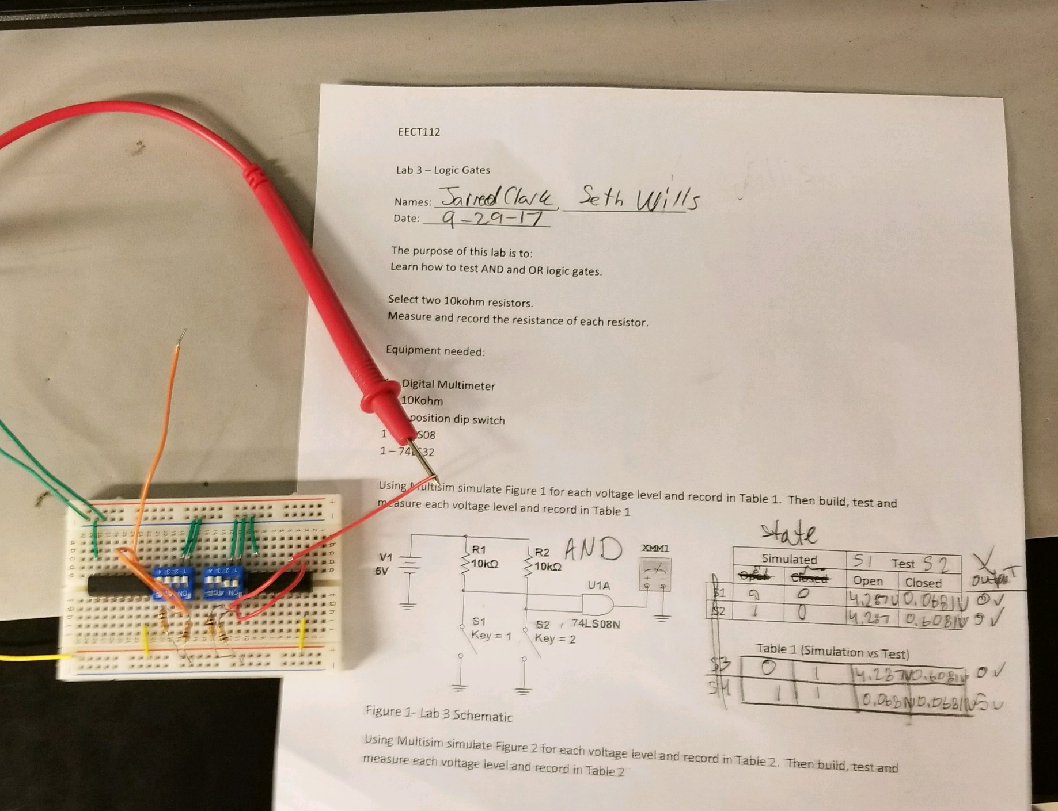
Lab 3- Page 7
Observations: Our measurements correspond with our multisim, and it referenced that each gate had an opposite input and it created an output. It wasn’t exactly five volts and it didn’t exactly drop to 0V.
Our original word document: Lab 3
This is the full completed circuit of Lab 3 and the Lab word document with the test data and results.

Slide 20
Lab 4- Lecture 3b Slide A
Lab Partners were Seth and Nathaniel
The Purpose of this lab was to learn more about describing Logic Circuits algebraically.
Equipment Needed: GDM-8245 Digital Multimeter
3- 10kohm resistors
1- 4 position dip switch
1- 74ls08
1- 74ls32

Slide 21
Lab 4- Page 2
This is our spreadsheet of every possible out come there is for each equation
Top is when switch 1 and 2 are connected to the AND gate and switch 3 is connected to the Or gate
The bottom one is when switch 1 and 2 are connected to the OR gate and switch three is connected to the AND gate.

Slide 22
Lab 4- Page 3
This is the simulation is a three input circuit including the equation (A+B)*C, consisting of an AND gate and a OR Gate and it made of using a Voltage of 5 volts and three switches

Slide 23
Lab 4- Page 4
This is a simulation of (A*B)+C, which is the repositioned IC’s circuit of the one on Slide 22

Slide 24
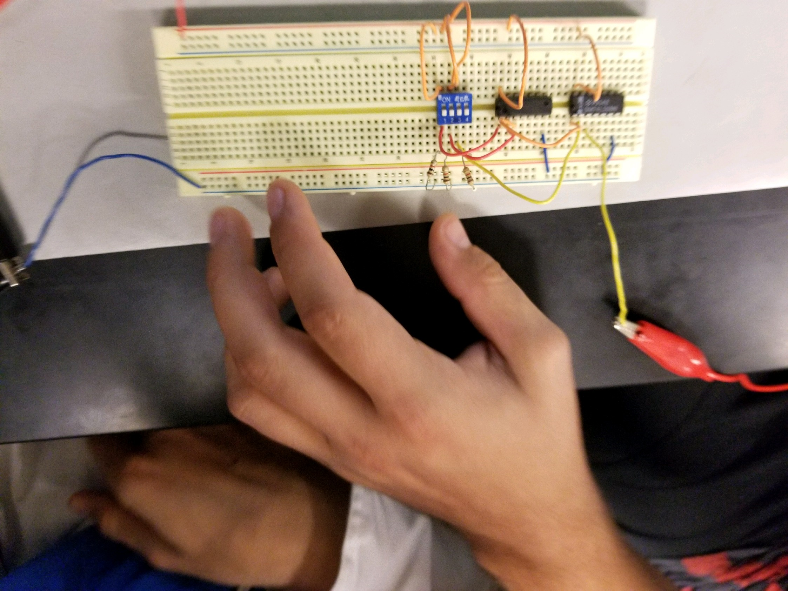
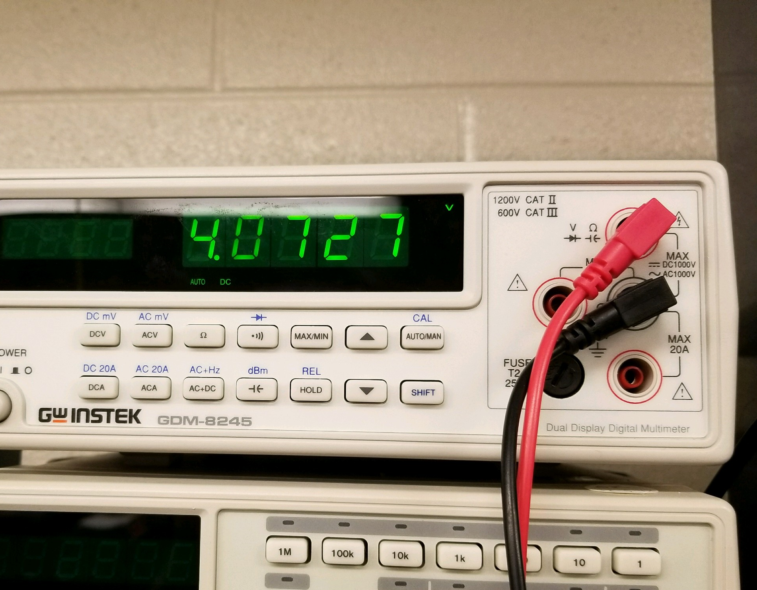
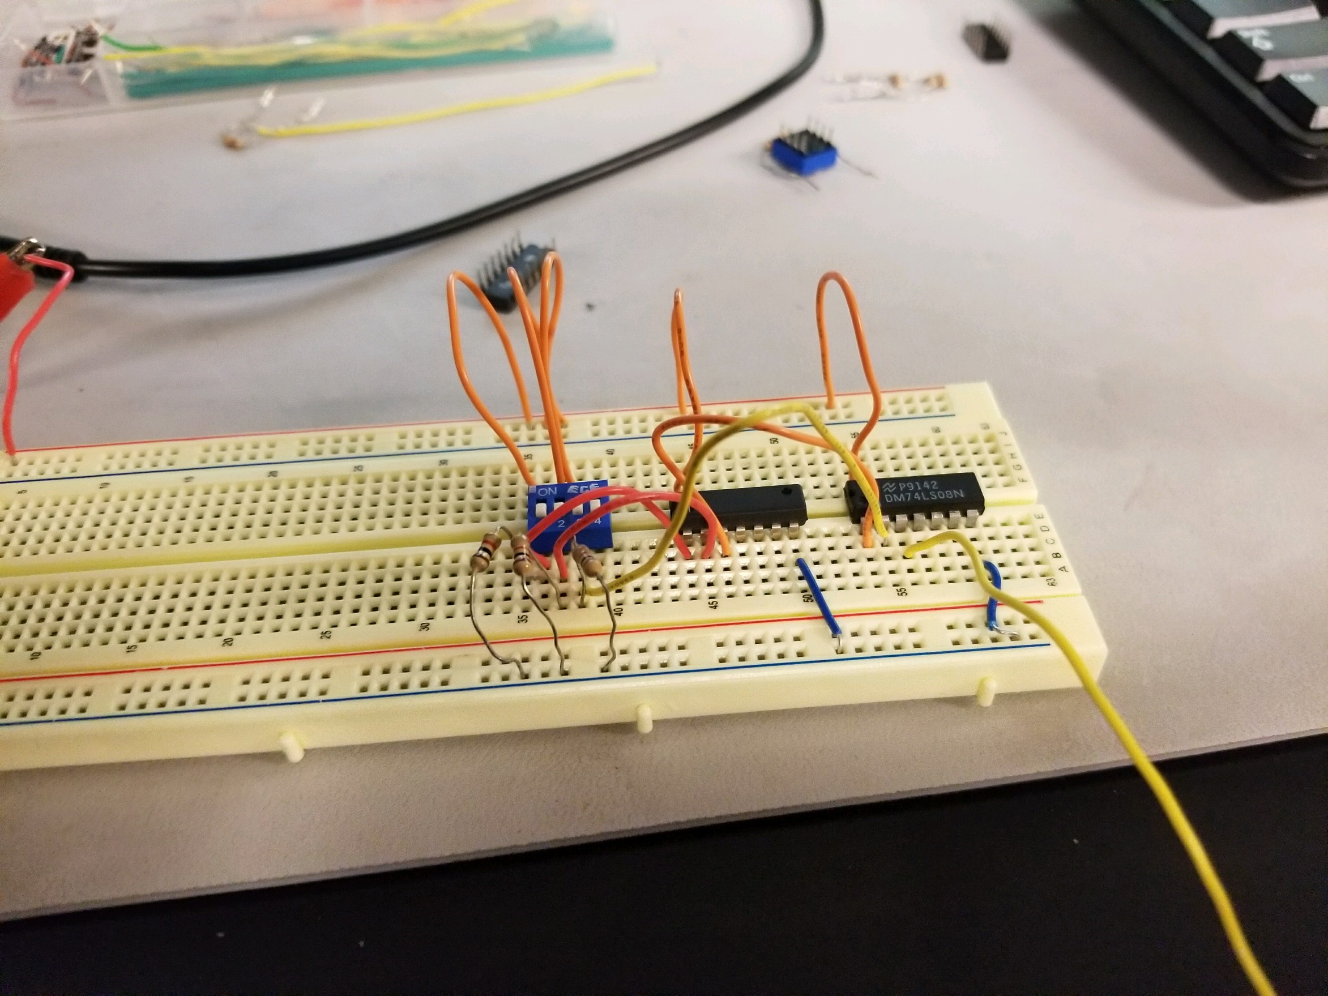
Lab 4- Page 4
Overview of the circuit (A+B)*C
High Reading
all three switches in a high state
Overview of the circuit
(A*B)+C

Slide 25
Lab 4 –Page 5
Observations: With the voltage being too low with the 10k resistor we started to use a 1k resistor to adjust the current. The real world voltage was about 4V rather than 5V.
Original Word Document for Lab 4

Slide 26
Lab 5- Two Input Gates 09-22-17
My Lab Partner was Seth Wills
The Purpose of this lab is to Learn how two input logic gates work using digital ICs, switches and resistors.
1 – GDM-8245 Digital Multimeter
2 – 10Kohm
1 – 4 position dip switch
1 – 74LS04 Hex Inverter
1 – 74LS08 Quad AND
1 – 74LS32 Quad OR
1 – 74LS86 Quad XOR

Slide 27
Lab 5- Page 2
This is our spreadsheet for all the possible outcomes for two input OR, AND, NAND, NOR, XOR, XNOR gates

Slide 28
Lab 5- Page 3
This is schematic is utilizing a 74LS32D quad OR gate IC. The truth table is included.
 | Ckt 1 Or Gate
A | B | Out
0 | 0 | 0
0 | 1 | 1
1 | 0 | 1
1 | 1 | 1

Slide 29
Lab 5- Page 4
This is schematic is utilizing a 74LS08D quad AND gate IC. The truth table is included.
 | Ckt 2 And Gate
A | B | Out
0 | 0 | 0
0 | 1 | 0
1 | 0 | 0
1 | 1 | 1

Slide 30
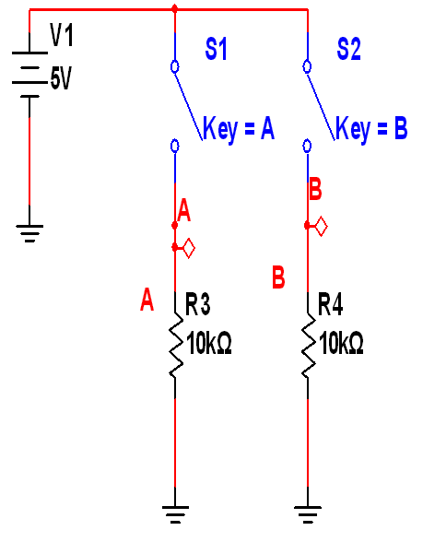
Lab 5- page 5
This is schematic is utilizing a 74LS00D quad NAND gate IC. The truth table is included.
 | Ckt 3 Nand Gate
A | B | Out
0 | 0 | 1
0 | 1 | 1
1 | 0 | 1
1 | 1 | 0

Slide 31
Lab 5- Page 6
This is schematic is utilizing a 74LS32D Dual input OR gate IC with using a combination with 74LS04 inverter. The truth table is included
 | Ckt4 Nor Gate
A | B | Out
0 | 0 | 1
0 | 1 | 0
1 | 0 | 0
1 | 1 | 0

Slide 32
Lab 5- Page 6
This is schematic is utilizing a 74LS08D Dual input AND gate IC with using a combination with 74LS04 inverter. The truth table is included
 | Ckt 5 Xor Gate
A | B | Out
0 | 0 | 0
0 | 1 | 1
1 | 0 | 1
1 | 1 | 0

Slide 33
Lab 5- Page 7
This is schematic is utilizing a 74LS86D quad XOR gate IC with using a combination with 74LS04 inverter to make it a XNOR Gate. The truth table is included.
 | Ckt 6 Xnor Gate
A | B | Out
0 | 0 | 1
0 | 1 | 0
1 | 0 | 0
1 | 1 | 1

Slide 34
Lab 6- Theorems
10-13-17
Lab Partners for the Simulations and results were Steve Kepler and Judo Abaker
Lab Partners for the Builds and Test data for the Circuits were Seth Wills, Alex Drummond and Emmanuel
The purpose of this lab is to provide the test data and the simulations for the test data
Equipment Needed: Digital Multimeter
74LS08
74LS32
74LS04

Slide 35
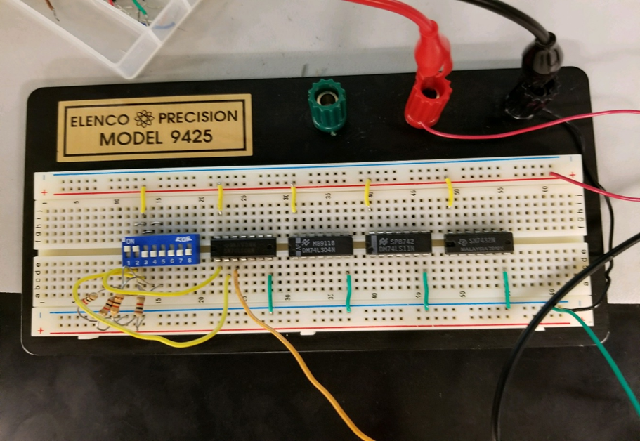

Lab 6-Page 2
Theorem 1 of Demorgans Theorems
This is the completed circuit for Theorems 1-3

Slide 36
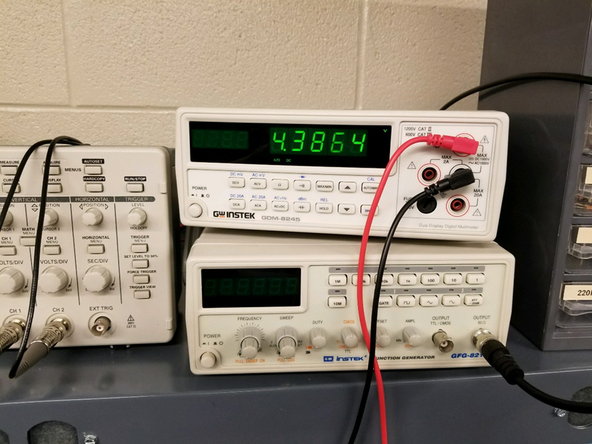

Lab 6- Page 3
Theorem 2 of Booleans Theorem

Slide 37

Lab 6- Page 4
Theorem 3 of Booleans Theorems

Slide 38
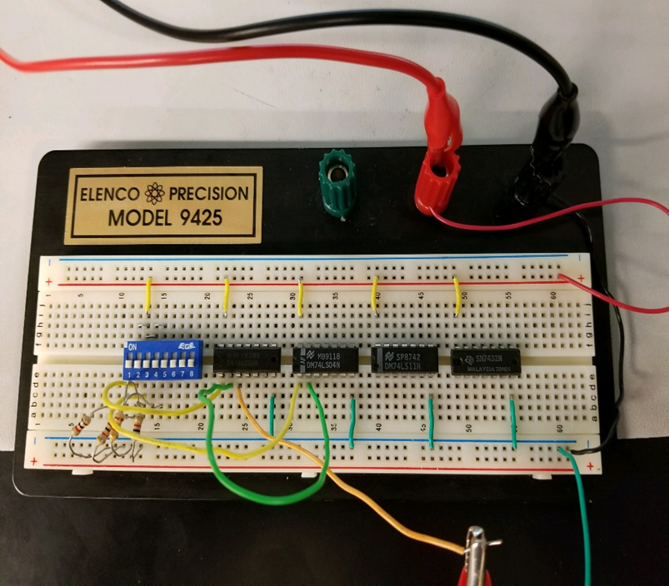
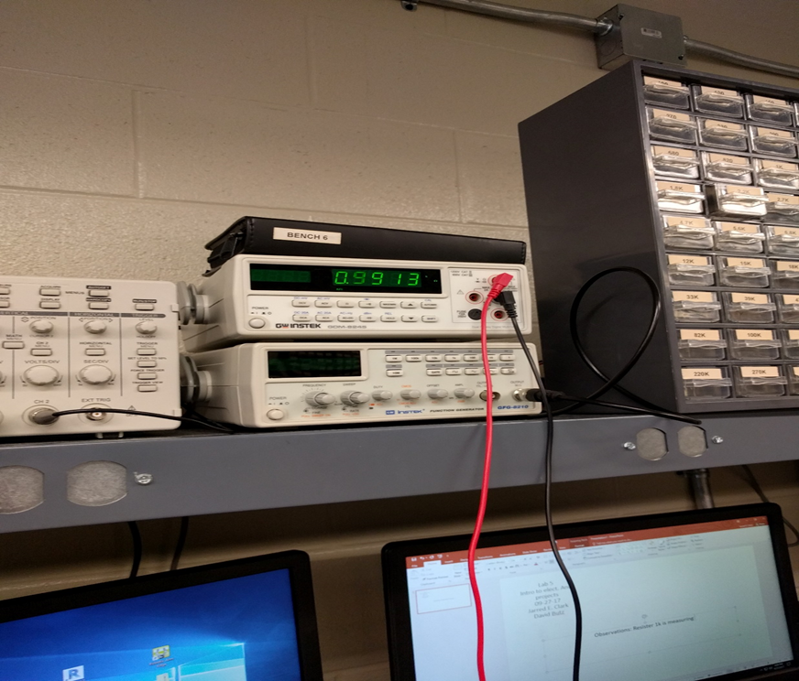

Lab 6- Page 5
Theorem 4 of Booleans Theorems
This is the finished circuit of theorem 4

Slide 39
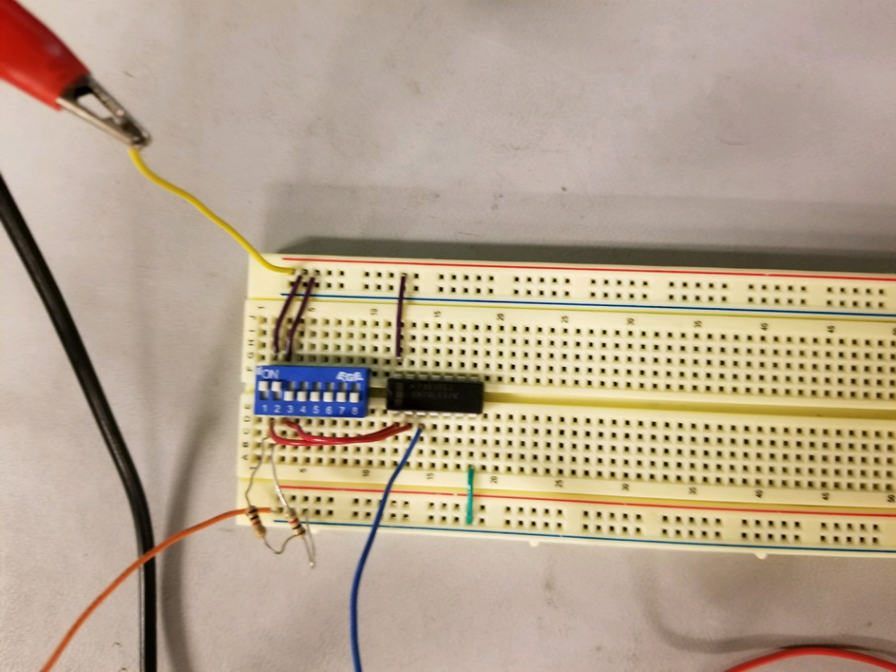
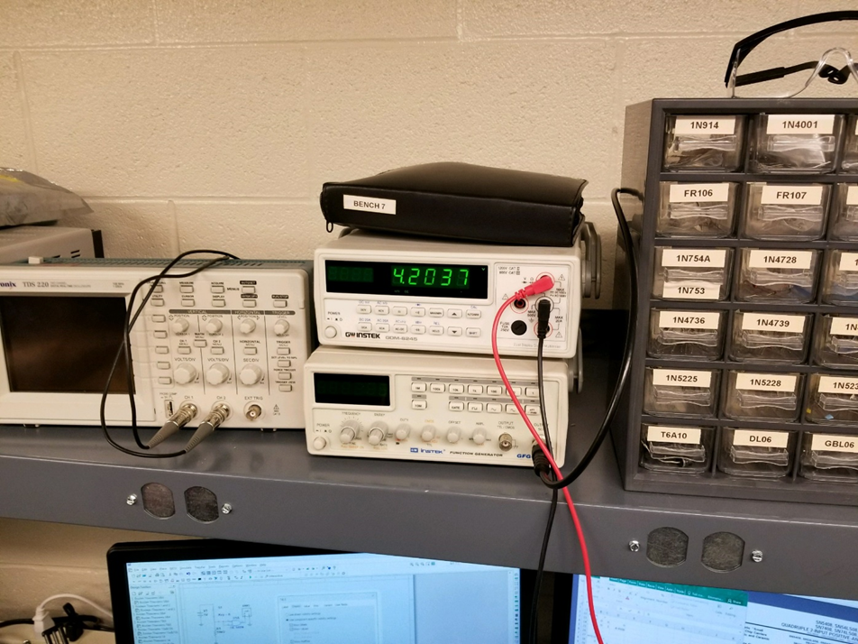

Lab 6- Page 6
Theorem 5 of Booleans Theorems
This is the completed circuit for Theorems 5-7

Slide 40

Lab 6- Page 7
Theorem 6 of Booleans theorem

Slide 41
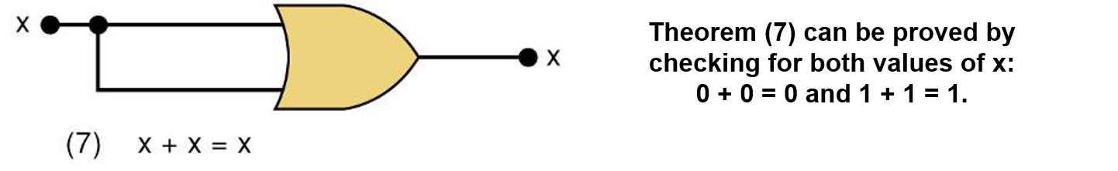
Lab 6 Page 8
Theorem 7 of Booleans Theorem

Slide 42
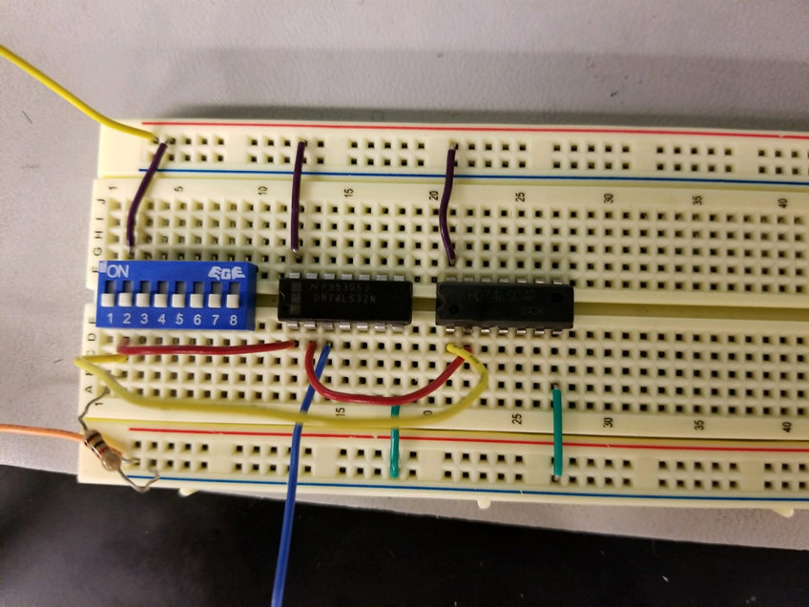


Lab 6 Page 9
Theorem 8 of Booleans Theorem
This is the completed circuit of Theorem 8

Slide 43
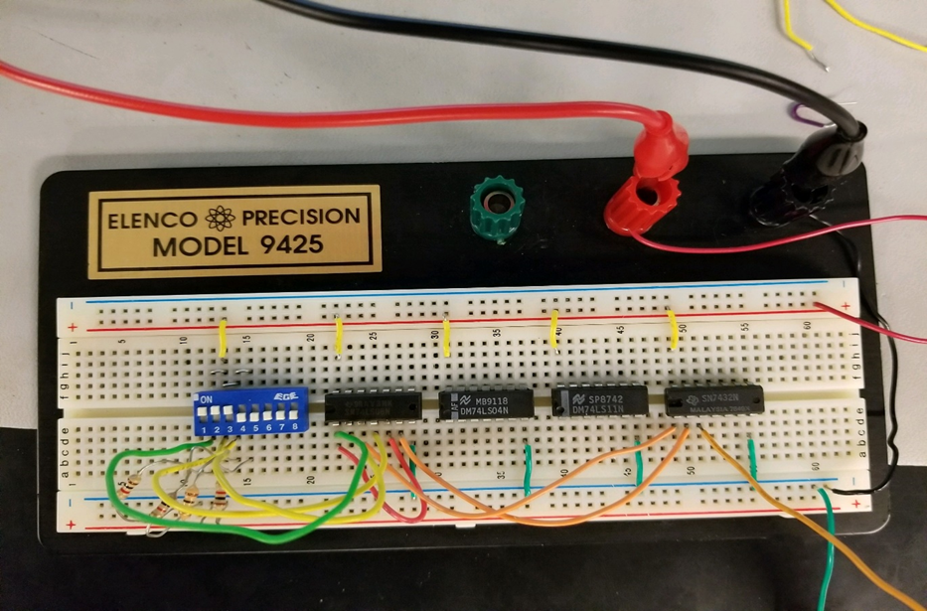
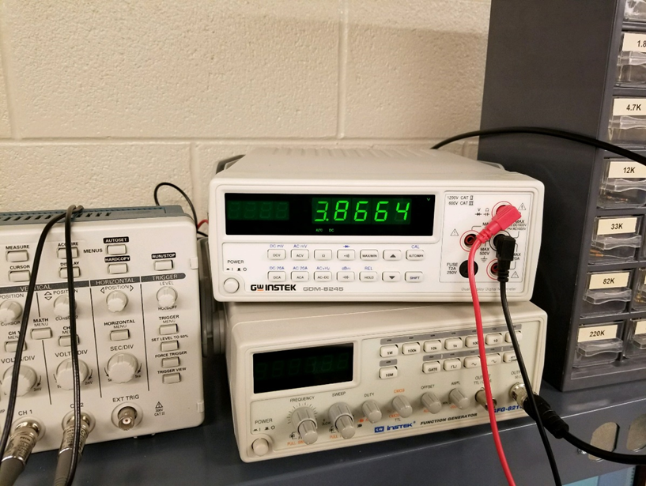

Lab 6- Page 10
Theorem 13a Part 1 of Booleans
Theorem
This is the completed circuit for Theorem 13 a Part 1

Slide 44
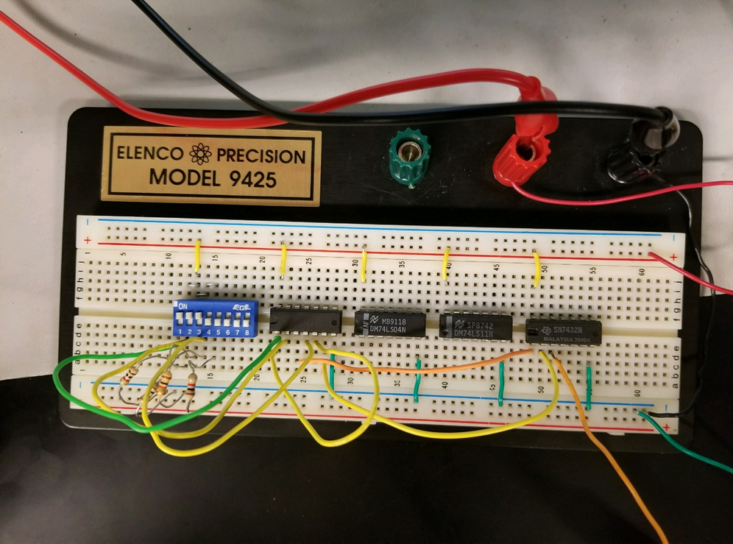
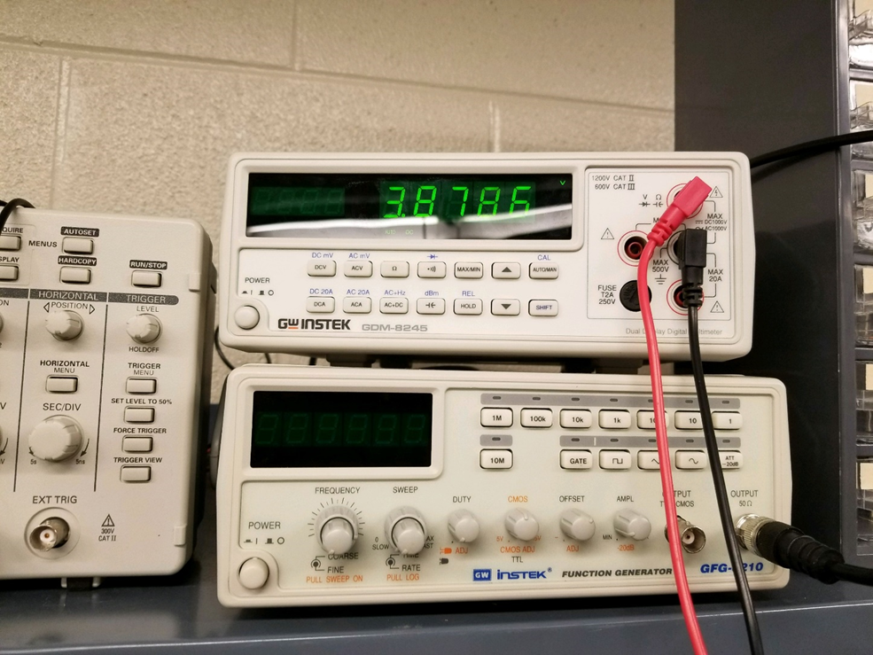
Lab 6- Page 11
Theorem 13a Part 2 of Demorgans Theorem
This is the complete circuit of Theorem 13 a Part 2

Slide 45
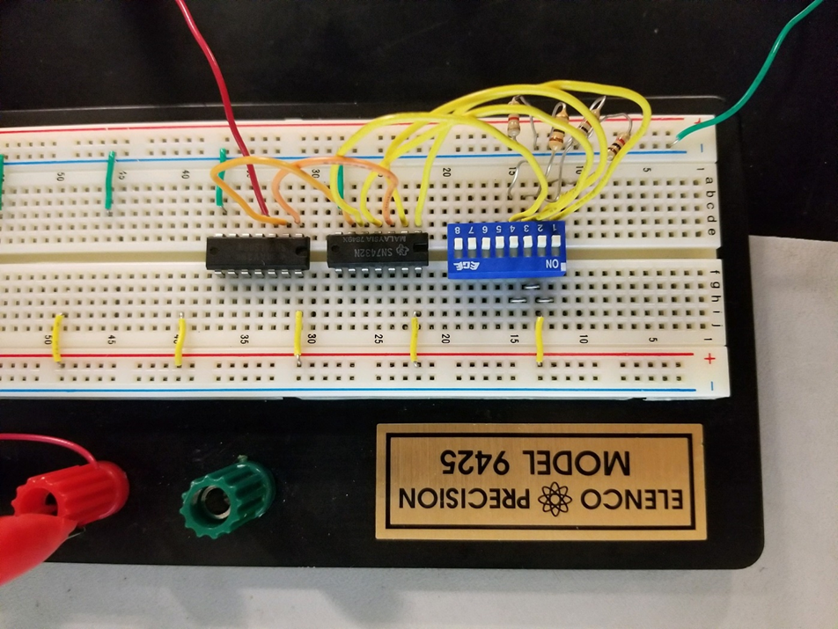
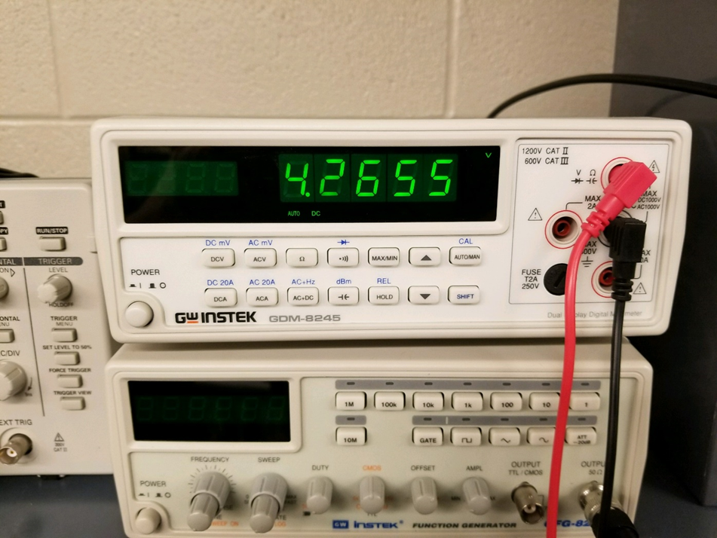
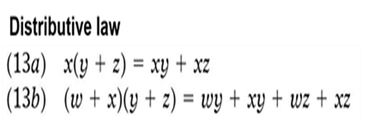
Lab 6- Page 12
Theorem 13b Part 1 of Demorgans Theorems
This is the completed circuit for Theorem 13b Part 1 and Part 2

Slide 46
Lab 6- Page 13
Theorem 13b Part 2 of Demorgans Theorem

Slide 47
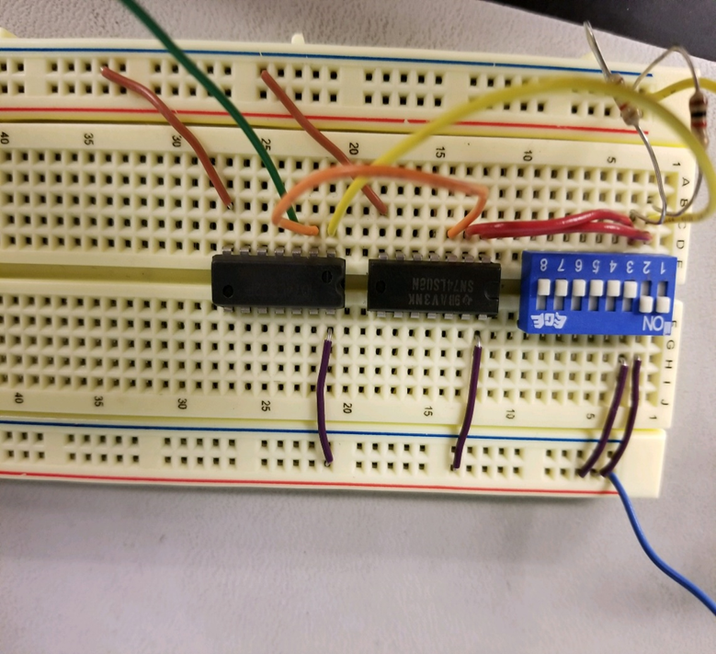
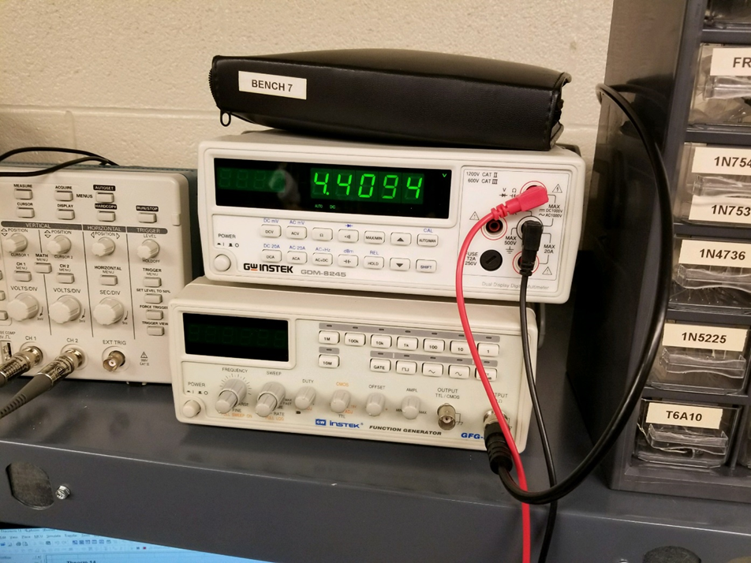
Lab 6- Page 14
Theorem 14 of Demorgans Theorems
Theorem 14 is x+xy=x
This is the completed circuit for Theorem 14

Slide 48
Lab 7- Circuit Reduction Part 1 10-27-17
My Lab Partner was Seth Wills
The purpose is to Learn how to reduce a circuit design down to the smallest size using the 17 Theorems and Karnaugh maps. Part 2 will explore how to reduce the circuit.
Equipment needed:
1 – Digital Multimeter
3 – 10Kohm
1 – 4 position dip switch
1 – 74LS04 Hex Inverter
1 – 74LS00 Quad NAND
1 – 74LS11 Triple 3 input AND
1 – 74LS32 Quad OR

Slide 49
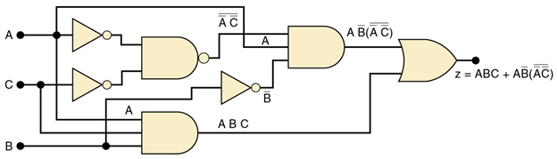
Lab 7- Page 2
This the schematic that we used to create the circuit and to make in multisim.

Slide 50
Lab 7- Page 3
This our schematic that we built for the circuit. We made connecting points from the switches and power supply to our schematic.

Slide 51
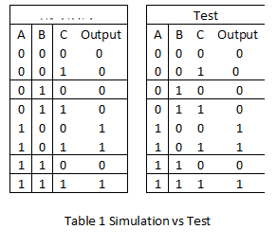
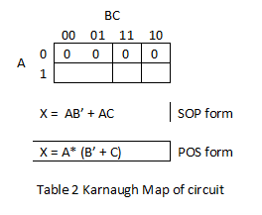
Lab 7- Page 4
This our test data for the equations for the circuit reduction. This is also our data for the results being simulated and tested in the Lab.
Simulated

Slide 52
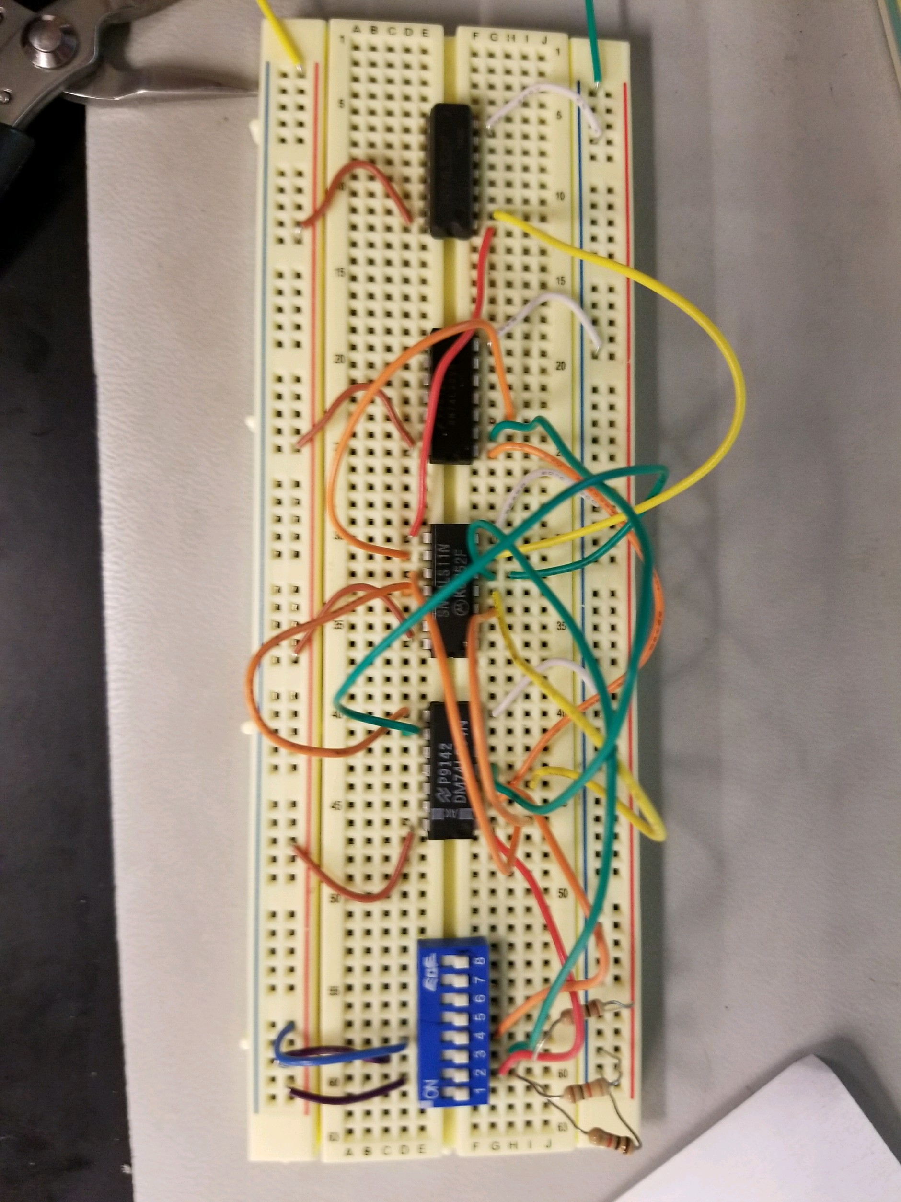
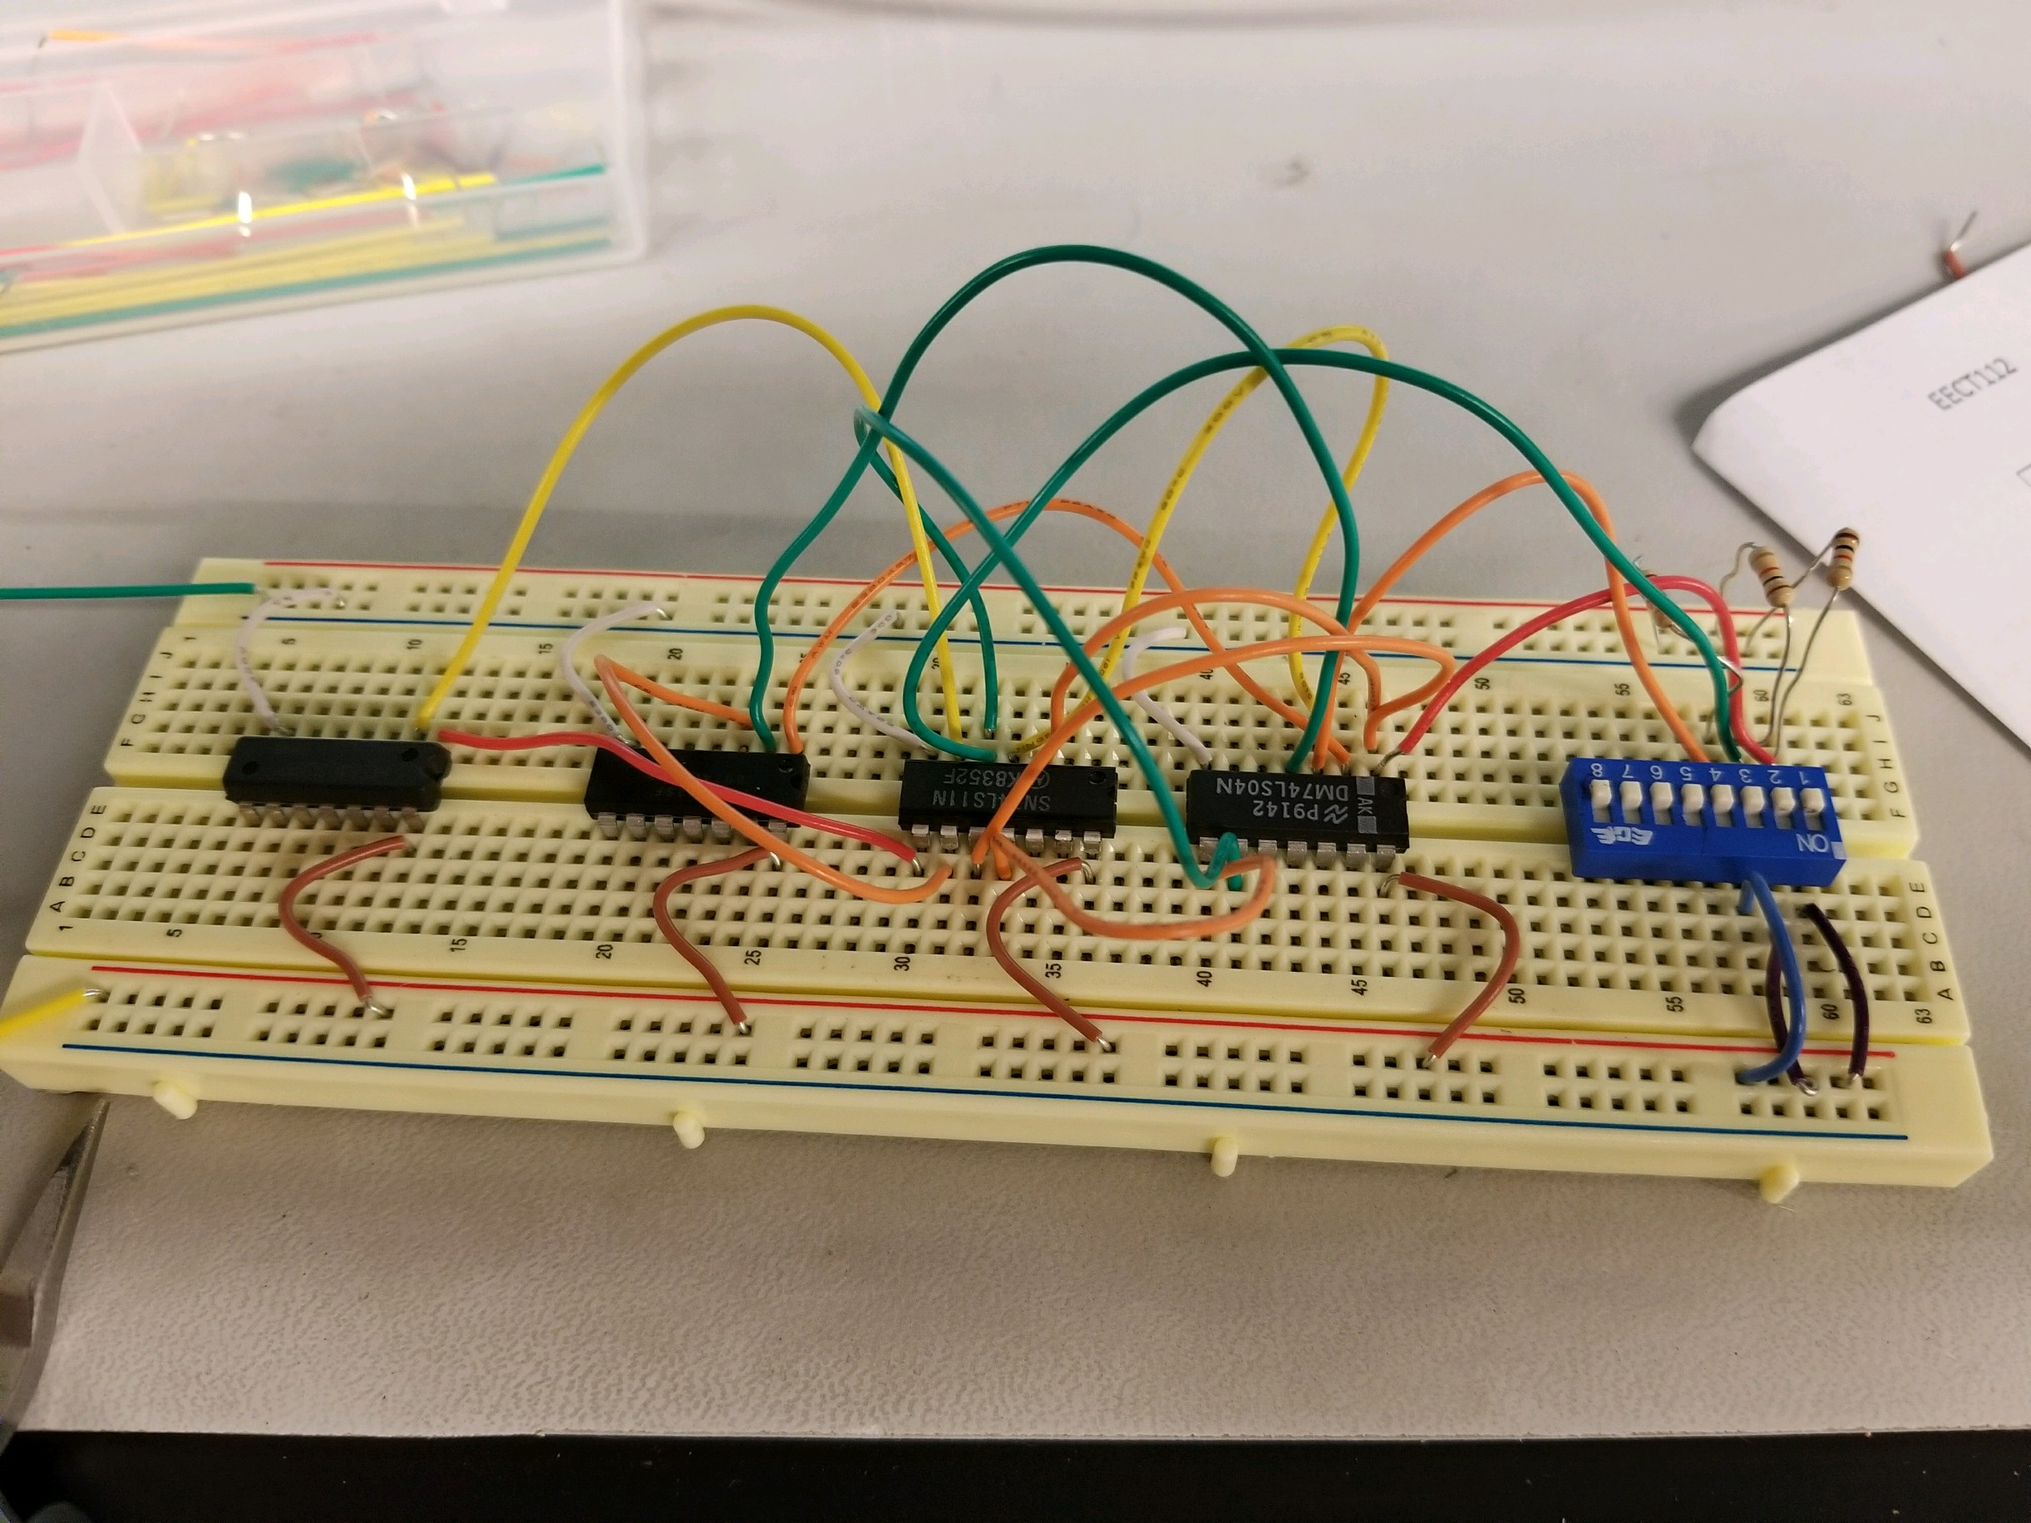
Lab 7- Page 5
This is the completed circuit for circuit before we reduced it in Lab 8

Slide 53
Lab 7- Page 6
Observations: This is the circuit where it can be simplified, but built in the lab and we came up with the SOP and POS equations in order to simplify the circuit in Lab 8
Our original word document Lab 7

Slide 54
Lab 8- Circuit Reduction Part 2
My Lab Partner was Seth Wills
The Purpose of this lab is to Learn how to reduce a circuit design down to the smallest size using the 17 Theorems and Karnaugh maps. Part 2 will explore how to reduce the circuit. You will also need the results of Lab 7.
Equipment needed:
1 – Digital Multimeter
3 – 10Kohm
1 – 4 position dip switch
1 – 74LS04 Hex Inverter
1 – 74LS08 Quad AND
1 – 74LS32 Quad OR

Slide 55
Lab 8- Page 2
This the simplified circuit in the Sum of Product form.
This consists of a 74ls04, 74ls32, and 74ls08. There is also connection points from the switches and power supply to the circuit.

Slide 56
Lab 8- Page 3
This the simplified circuit in the Product of Sum form.
This consists of a 74ls04, 74ls32, and 74ls08. There is also connection points from the switches and power supply to the circuit.

Slide 57
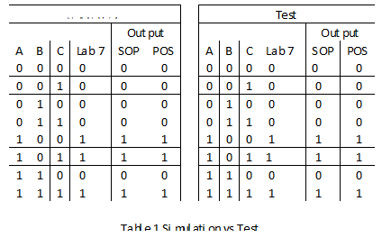
Lab 8- Page 4
Simulated
This is the Test data that compares our results from Lab 7 and it compares it to Lab 8 to see if it matches. This also contains simulated and test data in the Lab.

Slide 58
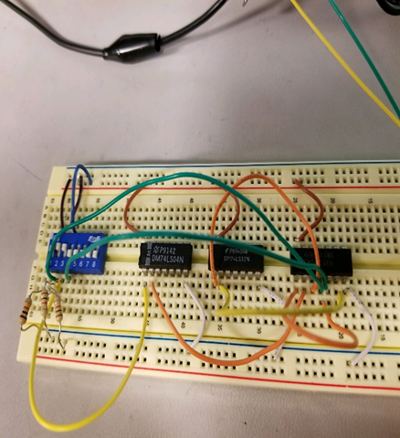
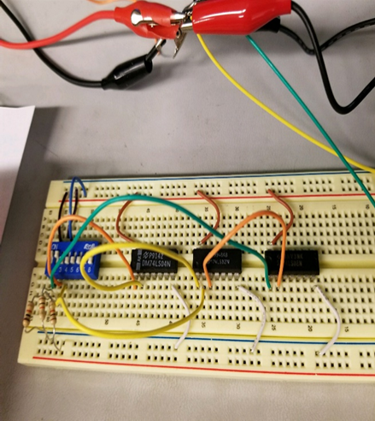
Lab 8- Page 5
This is the Sum of Product circuit that is completed
This is the Product of Sum circuit that is completed

Slide 59
Lab 8- Page 6
Observations: This is the simplified circuit from Lab 7 and this is simplified into two circuits and we got the same outcomes that we did for Lab 7.
This is the original document Lab 8

Slide 60
Lab 1- 1 to 3 clock using JK Flip Flops and 555 Timer 01-29-18
My Lab Partner was Seth Wills
The Purpose is to do as many times you can use multiple harmonically related clocks to test a combinational circuits. The Purpose of this lab is to show students how to create a small multiple clock counter circuit that uses JK Flip Flops and a 555 Timer.
Equipment needed:
1 – 555 Timer
1 – 1Kohm
1 – 8 position dip switch
2 – 74LS73 Dual JK flip flop with clear
2 – Resistors
2 – Capacitors

Slide 61
Lab 1- Page 2
This is the multisim schematic of just a single clock with two compacitors, 4.7k resistor, 100k resistor, and 555 Timer

Slide 62
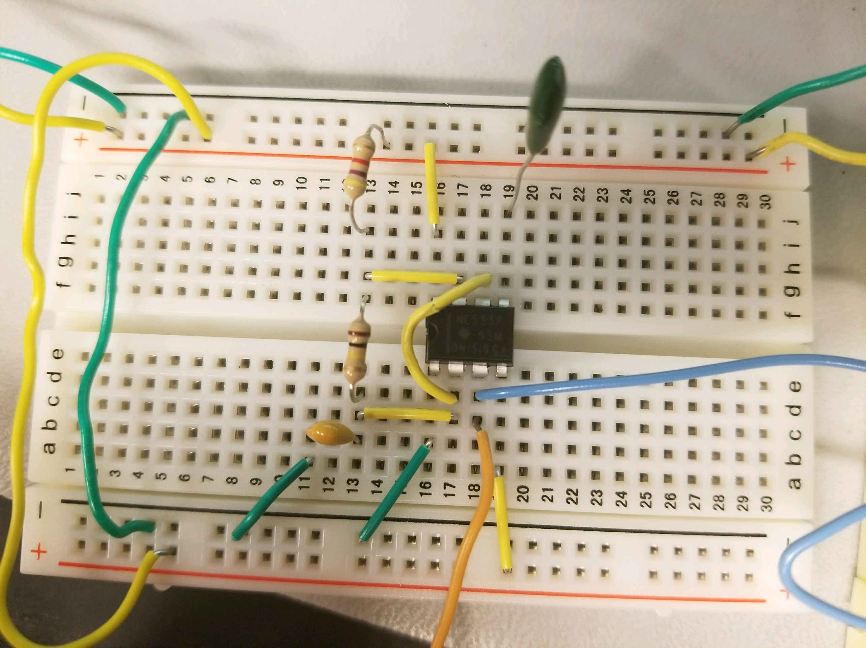
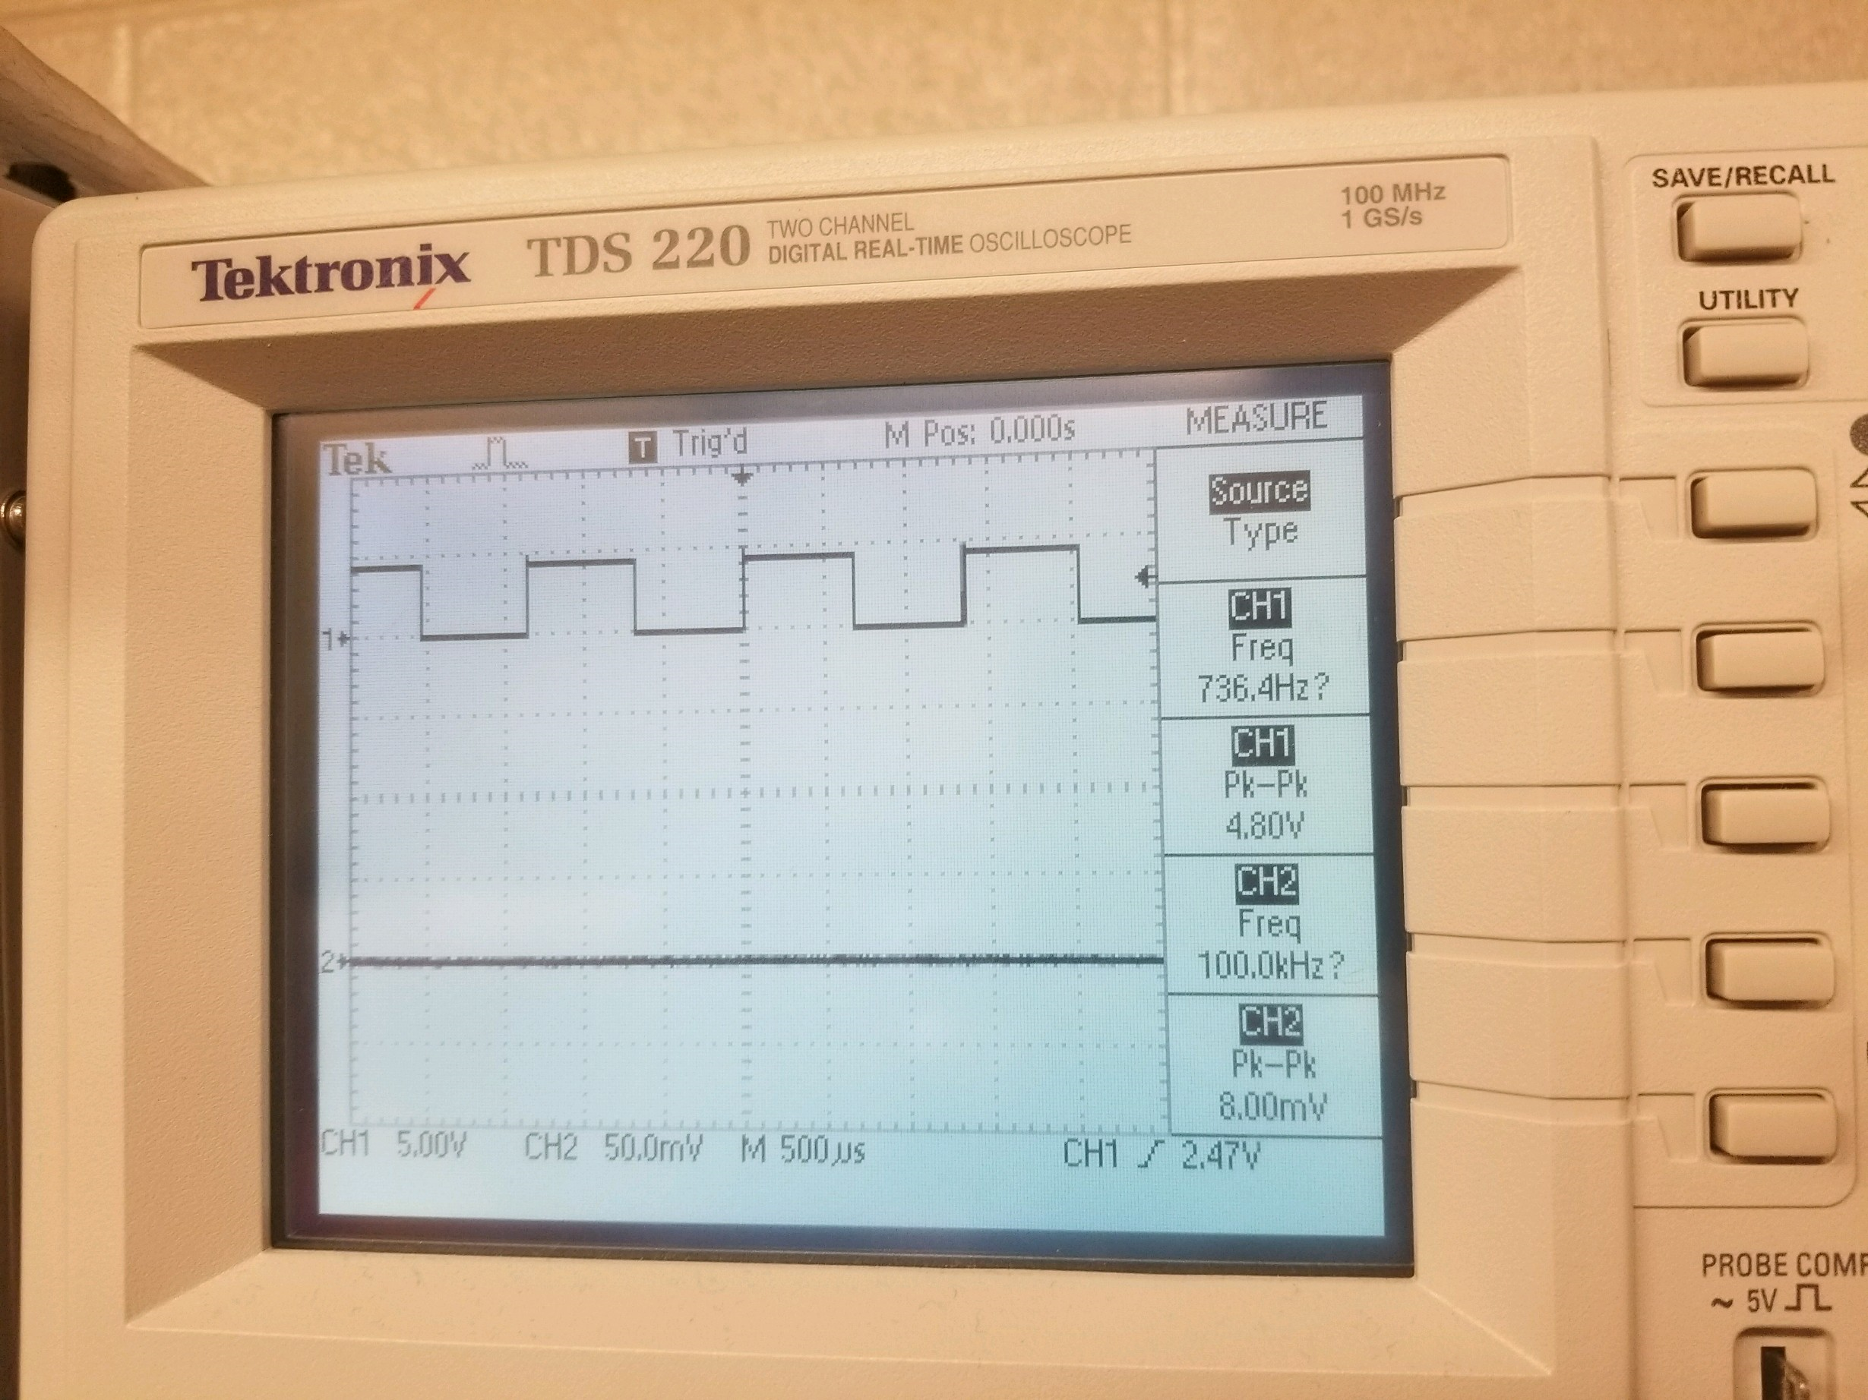
Lab 1- Page 3
This is the completed circuit for the first schematic from Lab 1
This is the correct oscilloscope reading for the circuit and it is reading at a frequency of 7hz.

Slide 63
Lab 1- Page 4
This is the multisim schematic for using a 1k resistor, 1 switch and 3 555 Timers.

Slide 64
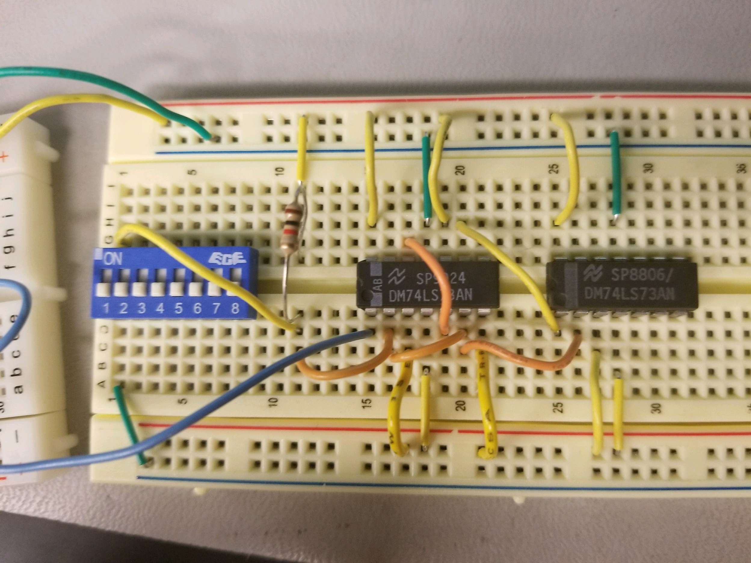
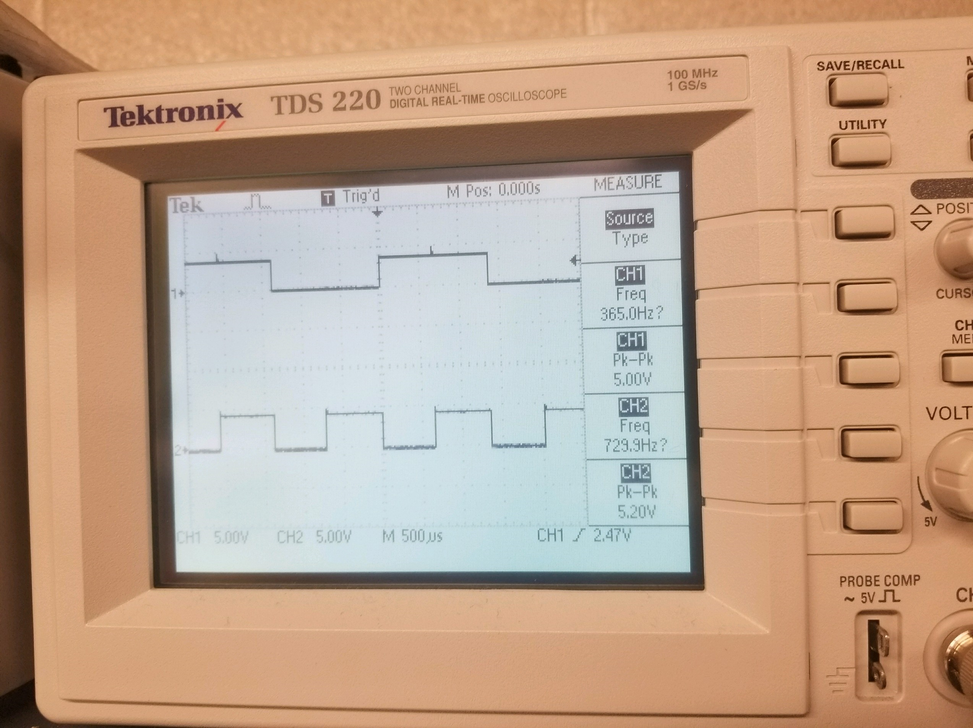
Lab 1- Page 5
This is the complete circuit build for the schematic on Lab 1 – Page 4
Test Data from the Oscilloscope

Slide 65
Lab 1- Page 6
This our test data and Lab data for the differences between simulated and tested

Slide 66
Lab 1- Page 7
Observation: The 74LS73 flip flop followed the clock being generated by the 555 Timer Out put

Slide 67
Datasheets for all Parts used in this Lab Notebook

Slide 68
Datasheets continued

Slide 69
Datasheets continued

Slide 70
Datasheets Continued

