Slide 1
Lab 2: LED
By: Dakota Johnson
Lab Partner: Josiah Abel
Instructor: Andy Bell
Bench Number: 6
Class: EECT 121-50C
Date: 12/15/2015

Slide 2
Objectives:
To find the fundamental characteristics of an LED using simulations and experimentation.
Equipment:
Digital Multi Meter Brand: GwInstek Model #: GDM-8245 SN: CL860332
Function Generator Brand: GwInstek Model #: GFG-8210 SN: C705245
DC Power Supply Model# HY1802D
Parts:
Miscellaneous Wires
1 150Ω Resistor
1 100Ω Resistor
1 08L53RD Light Emitting Diode

Slide 3
Simulations/Schematics:
Reversed LED
Regular LED
DC Power Supply was set to 5V. The 08l53 LED was placed in series with both a 150 ohm and 100 ohm resistor. The voltage was slowly adjusted until the LED turned on. In the second simulation the LED was reversed in the circuit so that the anode and cathode were in opposite positions.

Slide 4
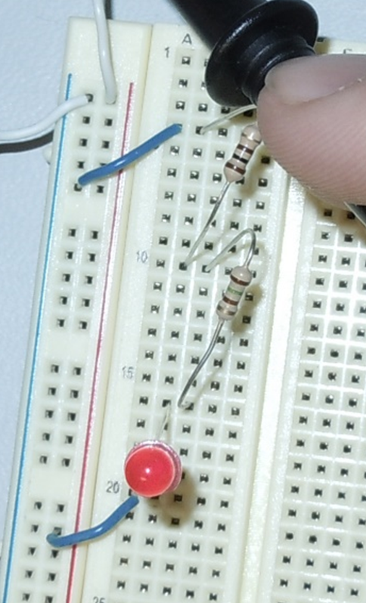
Lab Setup:
Reversed LED
Regular LED
100Ω Resistor
150Ω Resistor
LED
(Anode and Cathode switched in circuit)

Slide 5
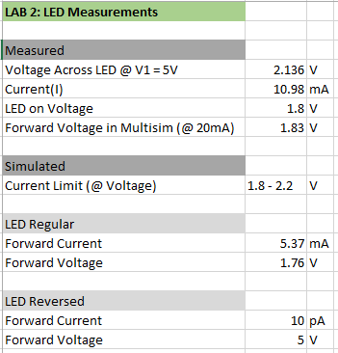
DATA:
A.
B.
Measurements of the LED when the Anode and cathode were properly placed in the circuit
Voltage reading when the LED turned on.

Slide 6
LED Brightness:

Slide 7
Troubleshooting:
When running the simulations the LED was not turning on, even under the correct circumstances. After careful examination it was determined that the simulation LED was not sensitive to the precise changes in voltage required. Modifying the LED in the simulation helped it to behave more realistically.
Note: After designing and completing this lab it was determined that a Photo Resistor could have been used in a more advanced way to measure the Brightness of the LED and thus more accurately observe characteristics.

Slide 8
Conclusions:
After the initial on voltage was determined for the LED it was observed that the brightness of the LED peaked at approximately 5 Volts DC.
An LED emits light when it is forward biased and current is flowing through it at the proper level.

Slide 9
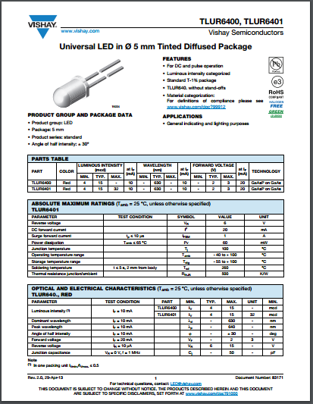
Data Sheets:
08L53RD LED

