Slide 1
Lab 8 JFET Transistor Amplifier Circuit
By: Dakota Johnson
Lab Partner: Sue Hlaing, Josiah Abel
Instructor: Andy Bell
Bench Number: 6
Class: EECT 121-50C
Date: 12/15/2015

Slide 2
Objectives:
Build a circuit using N-Type JFET that produces a voltage gain of 10.
Equipment and Parts:
Oscilloscope Brand: Tektronix Model #: TDS220 SN: B083266
Digital Multi Meter Brand: GwInstek Model #: GDM-8245 SN: CL860332
Function Generator Brand: GwInstek Model #: GFG-8210 SN: C705245
GW Instek LCR meter model#: LCR-819 SN#: E120998
DC Power Supply Model# HY1802D

Slide 3
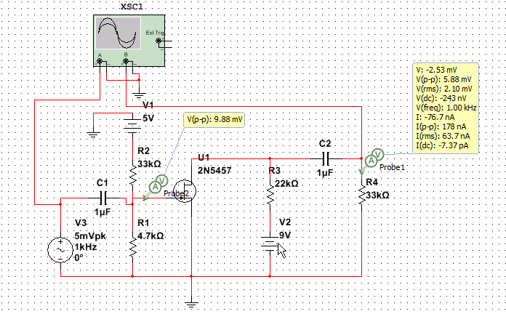
Data/Lab Results/Simulations/Schematics:
.model 2N5457DHJ NJF(Vto=-1.372 Beta=1.125m Lambda=2.3m
+ Vtotc=-2.5m Is=181.3f Isr=1.747p N=1 Nr=2 Xti=3 Alpha=2.543u
+ Vk=152.2 Cgd=4p M=.3114 Pb=.5 Fc=.5 Cgs=4.627p Kf=10.45E-18
+ Betatce=-.5 Rd=1 Rs=1 Af=1)
Model of 2N5457 used in the simulations
Multisim Schematics of the circuit.

Slide 4
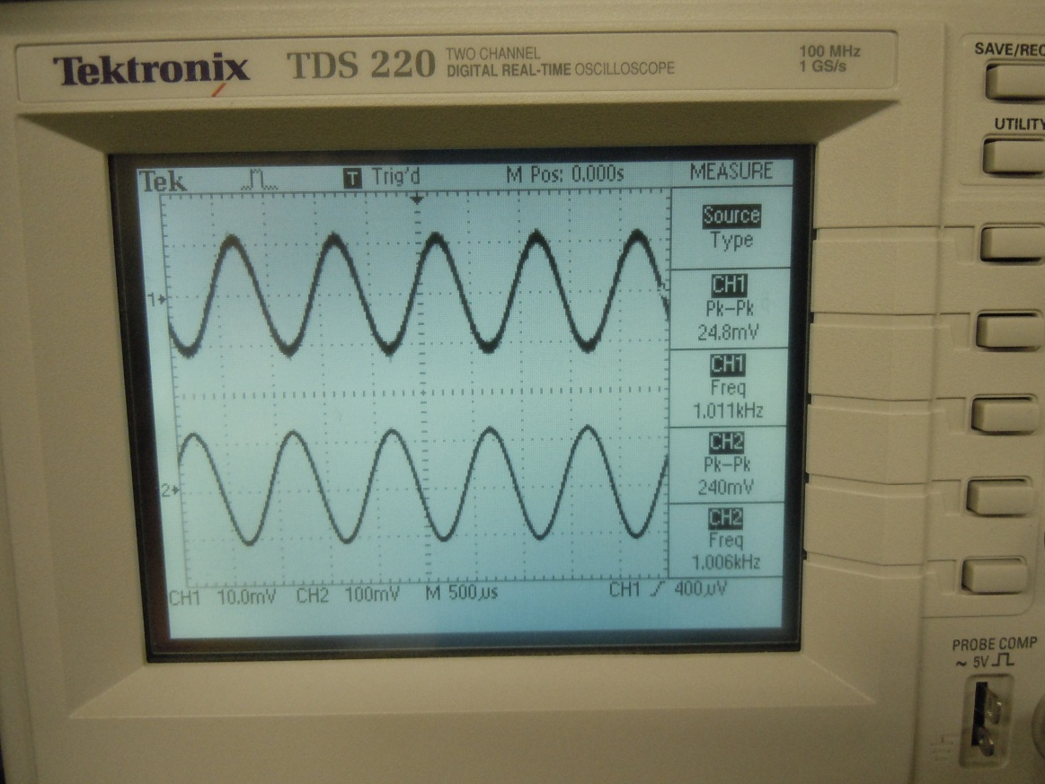
4.7kΩ Resistor
33kΩ Resistor
2N5457 N-Type JFET Transistor
22kΩ Resistor
1μF Capacitor
Oscilloscope reading of input and output voltage
 | Measured | Expected
V1 | -5.071 | -5 | V
V2 | 9.043 | 9 | V
Vin | 24.8 | 5 | mV Pk-Pk
Freq | 1 | 1 | kHz
C1 | 1.01 | 1 | μF
C2 | 0.948 | 1 | μF
R1 | 4.67 | 4.7 | kΩ
R2 | 32.6 | 33 | kΩ
R3 | 21.98 | 22 | kΩ
R4 | 32.89 | 33 | kΩ
Vout | 240 | 5.88 | mV Pk-Pk
β | 9.677419 | 1.176
33kΩ Resistor
Function generator settings

Slide 5
Troubleshooting:
The first simulation was working correctly but when the circuit was built in the lab with the simulations specifications the gain was only 3. The circuit was fixed by changing resistors R3 and R4 until a gain of 10 was achieved. This set up was then simulated and it was concluded that the part model used did not represent the actual part fully.

Slide 6
Conclusion:
The circuit was able to produce a voltage gain of 10.

Slide 7
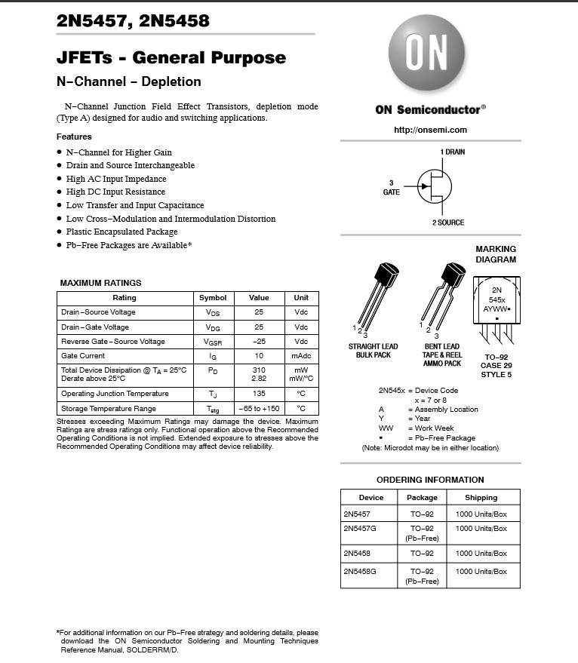
Data Sheets:
2N5457 N-Type Transistor

