Slide 1
Dual Power Supply Research
Evan Wilson
Jonathan Johnston
Cohlten Green

Slide 2
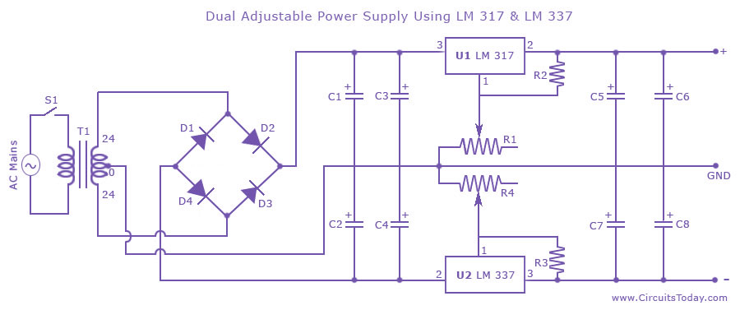
Design 1

Slide 3
Parts List 1
C1, C2 2200 uF 50V Electrolytic Capacitor C3, C4, C5, C7 2.2 uF 50V Electrolytic Capacitor C6, C8 100 uF 50V Electrolytic Capacitor R1, R4 5K Potentiometer R2, R3 220 Ohms 1/4 W Resistor D1 to D4 IN 4007 Diodes U1 LM317 U2 LM337 T1 24 0 24 Center Tapped 2 Ampere Transformer S1 SPST 2 Ampere Switch Extra Heat sinks for two IC’s , Power Cord, Casing, Wire etc

Slide 4
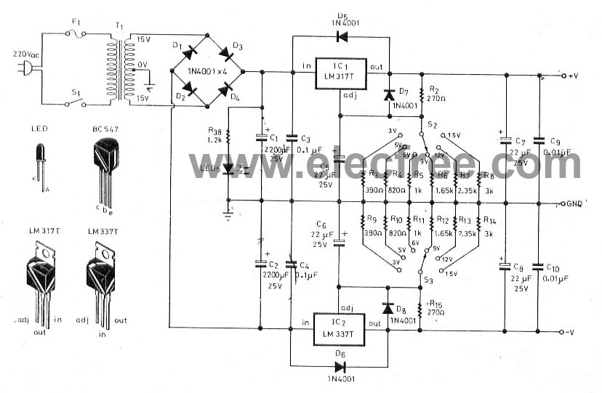
Design 2

