Slide 1
Dynamometer

Slide 2
Goal
To create a dynamometer based of the design from http://www.instructables.com/id/RC-Motor-Dynamometer-V10/
Test and measure small dc motors

Slide 3
Outline of Dyno
The dyno case will be 3d printed
An Arduino Uno will be used to control current to the motor and the take the readings from a sensor. The Arduino will calculate rpm from data from sensor
Dyno will be used to measure small dc motors

Slide 4
Circuit Parts List
1 IRL7833 MOSFET
1 TCRT1000 Optical Sensor
1 100 Ohm Resistor
1 1k Ohm Resistor
1 4.65k Ohm Resistor
1 100k Ohm Resistor
Arduino Uno
Arduino Uno prototype shield

Slide 5
Parts for Housing
Hot glue gun
3d printed wheel
3d printed Arduino housing
3d printed motor housing
3d printed sensor arm
Electrical tape

Slide 6
3D Parts

Slide 7
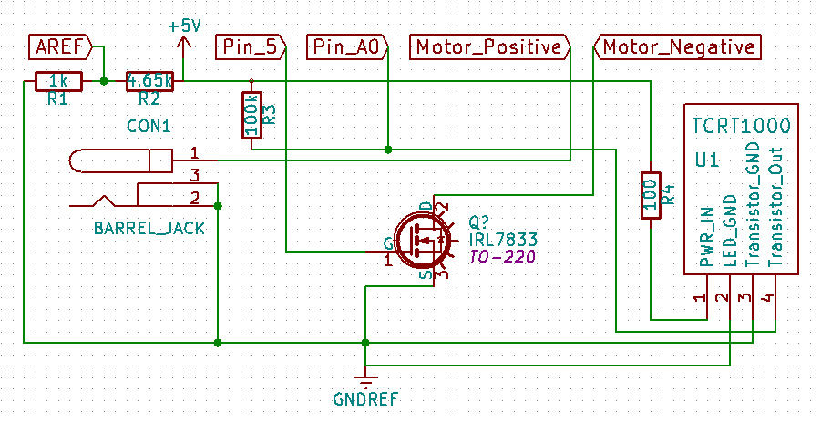
Schematic

Slide 8
Circuitry

Slide 9
Test Run

Slide 10
Analyzing The Data
The dyno is able to calculate the rpm at certain time intervals for us, now we can use excel to observe the polynomial that describes to motors behavior and calculus to calculate the torque and power.

Slide 11
Official Test Run
Dyno Test #1
Time | Velocity |  | Acceleration |  | Torque |  | Power
ms | RPM | Rad/s | RPM/s | r/s^2 | Nm | gcm | W
100 | 54 | 5.655 | 260.681 | 27.298 | 3.19E-04 | 3.257 | 1.81E-03
200 | 109 | 11.414 | 264.326 | 27.680 | 3.24E-04 | 3.302 | 3.70E-03
300 | 54 | 5.655 | 267.742 | 28.038 | 3.28E-04 | 3.345 | 1.86E-03
400 | 109 | 11.414 | 270.931 | 28.372 | 3.32E-04 | 3.385 | 3.79E-03
500 | 109 | 11.414 | 273.900 | 28.683 | 3.36E-04 | 3.422 | 3.83E-03
600 | 163 | 17.069 | 276.653 | 28.971 | 3.39E-04 | 3.456 | 5.79E-03
700 | 218 | 22.829 | 279.194 | 29.237 | 3.42E-04 | 3.488 | 7.81E-03
800 | 163 | 17.069 | 281.530 | 29.482 | 3.45E-04 | 3.517 | 5.89E-03
900 | 272 | 28.484 | 283.663 | 29.705 | 3.48E-04 | 3.544 | 9.90E-03
1000 | 272 | 28.484 | 285.600 | 29.908 | 3.50E-04 | 3.568 | 9.97E-03
1100 | 272 | 28.484 | 287.345 | 30.091 | 3.52E-04 | 3.590 | 1.00E-02
1200 | 327 | 34.243 | 288.902 | 30.254 | 3.54E-04 | 3.609 | 1.21E-02
1300 | 381 | 39.898 | 290.278 | 30.398 | 3.56E-04 | 3.627 | 1.42E-02
1400 | 381 | 39.898 | 291.475 | 30.523 | 3.57E-04 | 3.642 | 1.42E-02
1500 | 381 | 39.898 | 292.500 | 30.631 | 3.58E-04 | 3.654 | 1.43E-02
1600 | 490 | 51.313 | 293.357 | 30.720 | 3.59E-04 | 3.665 | 1.84E-02
1700 | 436 | 45.658 | 294.050 | 30.793 | 3.60E-04 | 3.674 | 1.64E-02
1800 | 490 | 51.313 | 294.586 | 30.849 | 3.61E-04 | 3.680 | 1.85E-02
1900 | 545 | 57.072 | 294.967 | 30.889 | 3.61E-04 | 3.685 | 2.06E-02
2000 | 545 | 57.072 | 295.200 | 30.913 | 3.62E-04 | 3.688 | 2.06E-02
2100 | 600 | 62.832 | 295.289 | 30.923 | 3.62E-04 | 3.689 | 2.27E-02
2200 | 600 | 62.832 | 295.238 | 30.917 | 3.62E-04 | 3.689 | 2.27E-02
2300 | 654 | 68.487 | 295.054 | 30.898 | 3.62E-04 | 3.686 | 2.48E-02
2400 | 654 | 68.487 | 294.739 | 30.865 | 3.61E-04 | 3.682 | 2.47E-02
2500 | 654 | 68.487 | 294.300 | 30.819 | 3.61E-04 | 3.677 | 2.47E-02
2600 | 763 | 79.901 | 293.741 | 30.760 | 3.60E-04 | 3.670 | 2.88E-02
2700 | 709 | 74.246 | 293.066 | 30.690 | 3.59E-04 | 3.662 | 2.67E-02
2800 | 763 | 79.901 | 292.282 | 30.608 | 3.58E-04 | 3.652 | 2.86E-02
2900 | 818 | 85.661 | 291.391 | 30.514 | 3.57E-04 | 3.641 | 3.06E-02
3000 | 818 | 85.661 | 290.400 | 30.411 | 3.56E-04 | 3.628 | 3.05E-02
3100 | 818 | 85.661 | 289.313 | 30.297 | 3.54E-04 | 3.615 | 3.04E-02
3200 | 872 | 91.316 | 288.134 | 30.173 | 3.53E-04 | 3.600 | 3.22E-02
3300 | 927 | 97.075 | 286.870 | 30.041 | 3.51E-04 | 3.584 | 3.41E-02
3400 | 872 | 91.316 | 285.523 | 29.900 | 3.50E-04 | 3.567 | 3.19E-02
3500 | 981 | 102.730 | 284.100 | 29.751 | 3.48E-04 | 3.549 | 3.58E-02
3600 | 927 | 97.075 | 282.605 | 29.594 | 3.46E-04 | 3.531 | 3.36E-02
3700 | 1036 | 108.490 | 281.042 | 29.431 | 3.44E-04 | 3.511 | 3.74E-02
3800 | 981 | 102.730 | 279.418 | 29.261 | 3.42E-04 | 3.491 | 3.52E-02
3900 | 1036 | 108.490 | 277.735 | 29.084 | 3.40E-04 | 3.470 | 3.69E-02
4000 | 1090 | 114.145 | 276.000 | 28.903 | 3.38E-04 | 3.448 | 3.86E-02
4100 | 1036 | 108.490 | 274.217 | 28.716 | 3.36E-04 | 3.426 | 3.64E-02
4200 | 1145 | 119.904 | 272.390 | 28.525 | 3.34E-04 | 3.403 | 4.00E-02
4300 | 1090 | 114.145 | 270.526 | 28.329 | 3.31E-04 | 3.380 | 3.78E-02
4400 | 1145 | 119.904 | 268.627 | 28.131 | 3.29E-04 | 3.356 | 3.95E-02
4500 | 1254 | 131.319 | 266.700 | 27.929 | 3.27E-04 | 3.332 | 4.29E-02
4600 | 1145 | 119.904 | 264.749 | 27.724 | 3.24E-04 | 3.308 | 3.89E-02
4700 | 1200 | 125.664 | 262.778 | 27.518 | 3.22E-04 | 3.283 | 4.05E-02
4800 | 1254 | 131.319 | 260.794 | 27.310 | 3.20E-04 | 3.258 | 4.20E-02
4900 | 1254 | 131.319 | 258.799 | 27.101 | 3.17E-04 | 3.233 | 4.16E-02
5000 | 1254 | 131.319 | 256.800 | 26.892 | 3.15E-04 | 3.208 | 4.13E-02
5100 | 1254 | 131.319 | 254.801 | 26.683 | 3.12E-04 | 3.183 | 4.10E-02
5200 | 1309 | 137.078 | 252.806 | 26.474 | 3.10E-04 | 3.159 | 4.25E-02
5300 | 1309 | 137.078 | 250.822 | 26.266 | 3.07E-04 | 3.134 | 4.21E-02
5400 | 1363 | 142.733 | 248.851 | 26.060 | 3.05E-04 | 3.109 | 4.35E-02
5500 | 1363 | 142.733 | 246.900 | 25.855 | 3.03E-04 | 3.085 | 4.32E-02
5600 | 1363 | 142.733 | 244.973 | 25.653 | 3.00E-04 | 3.061 | 4.28E-02
5700 | 1363 | 142.733 | 243.074 | 25.455 | 2.98E-04 | 3.037 | 4.25E-02

Slide 12
Graphs

Slide 13
Thoughts

